Slide 1


Artificial Intelligence for Systems Engineering: Requirements Identification
May 7, 2021
Faculty Presentation
Team Members:
Omid Shirazi
Megan Taylor
Michael Tzimourakas
Alex Zepka
Notes:
Alex

Slide 2
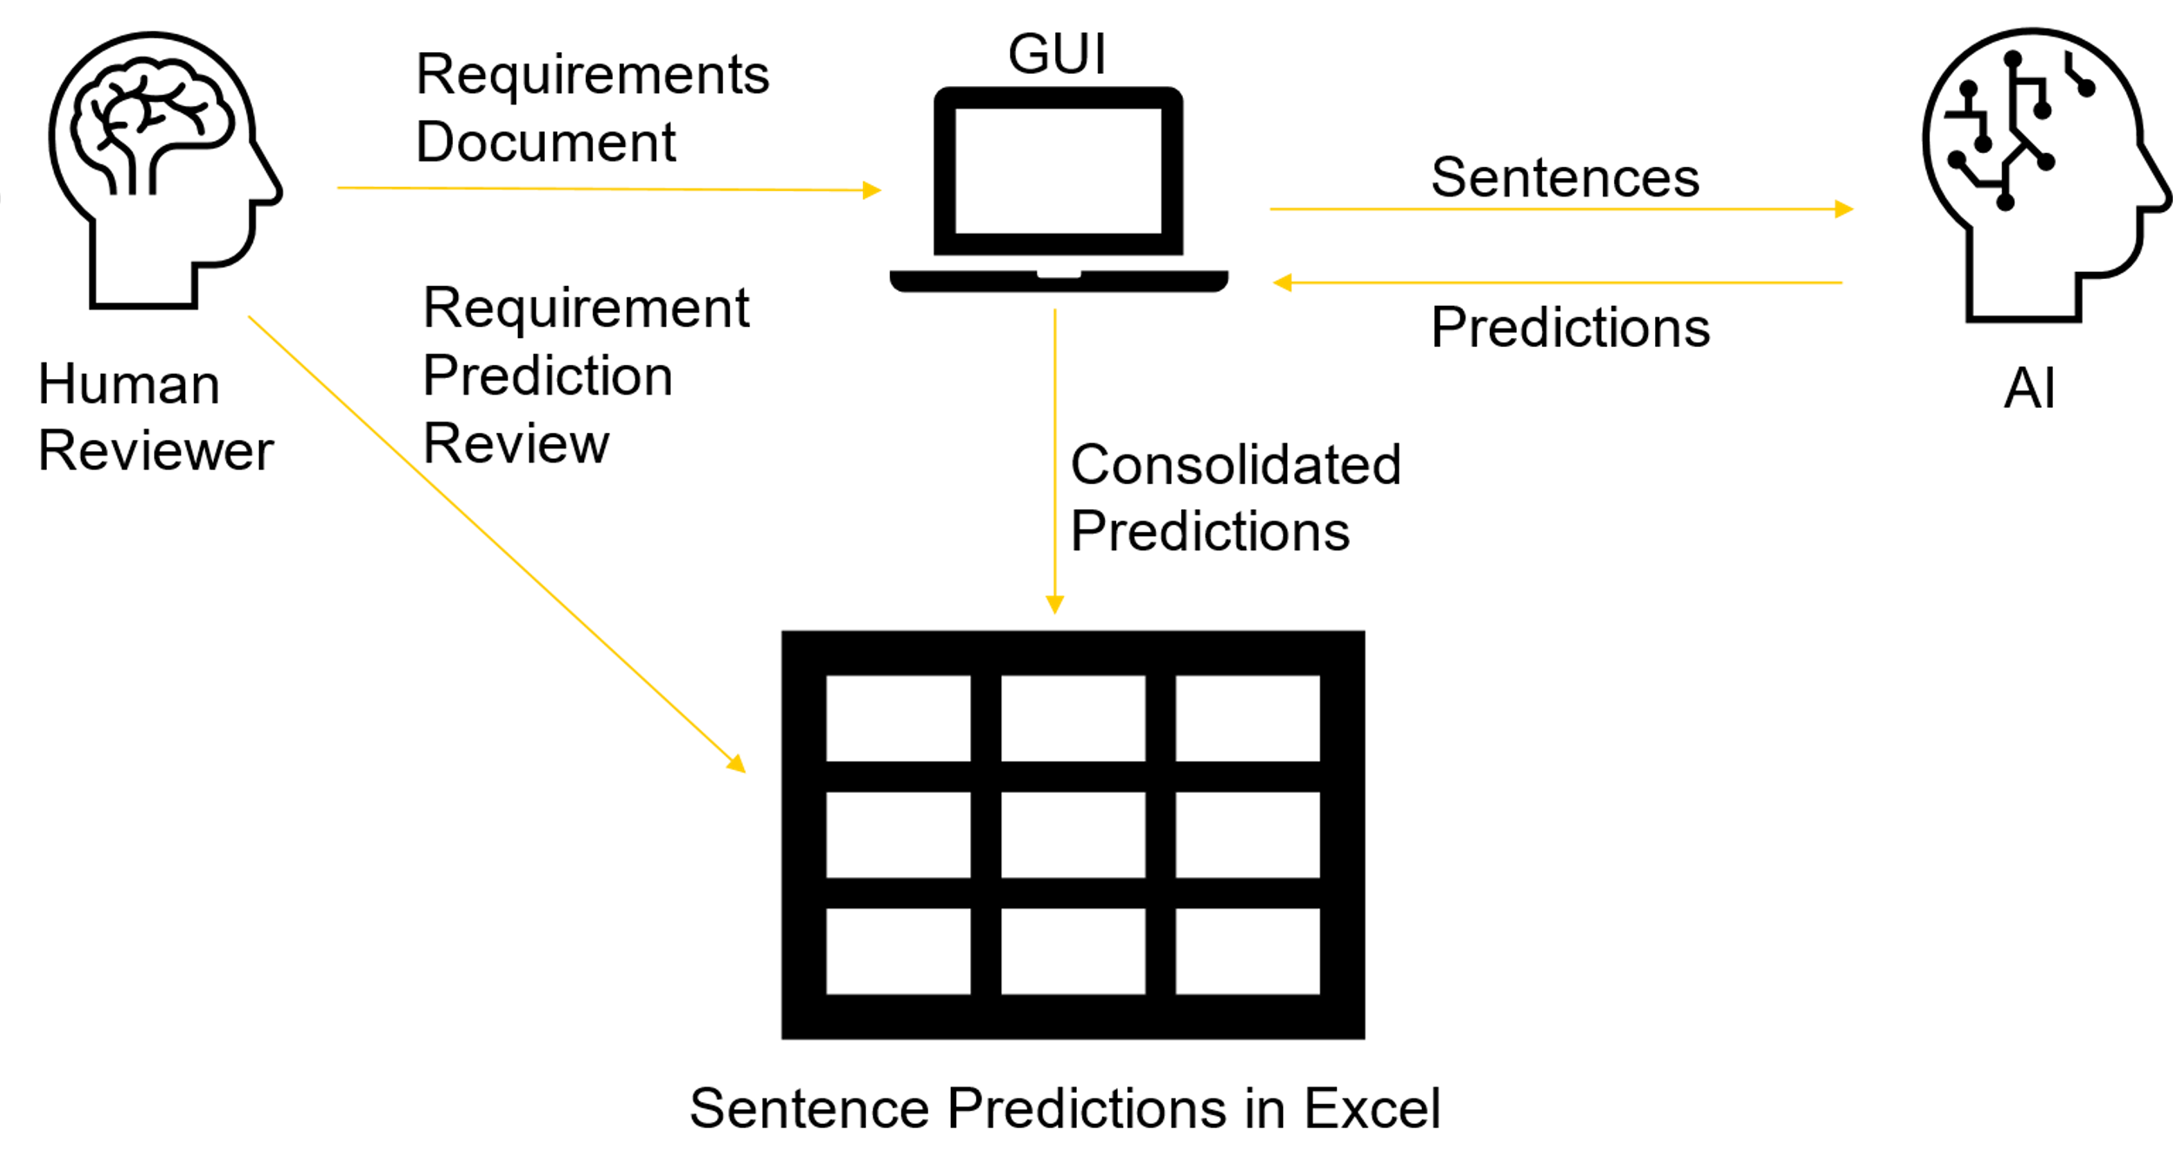
Executive Summary
Systems Engineering: Requirements Identification
Need to determine if AI can be leveraged in a way to increase the quality and accuracy of the engineering process and can it improve outcomes
Requirements management is a complex, time-consuming, and tedious process that relies on a lot of attention to detail. Often, a reviewer goes through 100+ documents to elicit requirements
Current Requirement Analysis Tools do not cover this problem.
To-Be Process
Feed requirements document to system, split into sentences, and let AI predict whether the sentence is a requirement. Output spreadsheet of requirements.
Design
Build 3 different Neural Networks to compare and combine results to get the requirement predictions
Deliverable #1: Sentence Slicer
Deliverable #2: Model Trainer
Deliverable #3: Requirement Predictor
Results
Reduce workload by 50% and elicit 90% of true requirements
Reduce workload by 80% and elicit 50% of true requirements
Concept of Operations
Notes:
Alex

Slide 3
Agenda
Background
To-Be Process
Design and Implementation
Results
Prototype
Future Work
Notes:
Alex

Slide 4
Requirements Collection Process
Proposal review process is necessary but time-consuming process from the perspective of the solicitors
Must sift through dozens of 100+ page responses
Historical performance, future forecasts, costs, and proposed specifications
Government solicitation review teams are composed of:
Core government team that wrote the offer
Coalition of domain experts from other agencies/departments and FFRDCs (Federally Funded Research and Development Centers)
Review team challenges:
Undermanned
Each reviewer analyze many proposals in a short amount of time
Held to the FAR (Federal Acquisition Regulation) system
Guides how the proposals are to be evaluated.
Historical AI/ML in Systems Engineering does not cover this need
QuARS, Raven, KaOS, useful requirements analysis tools, as long as you feed it the requirements first
Only other mention is using ML for fault analysis strategizing
Notes:
Alex

Slide 5
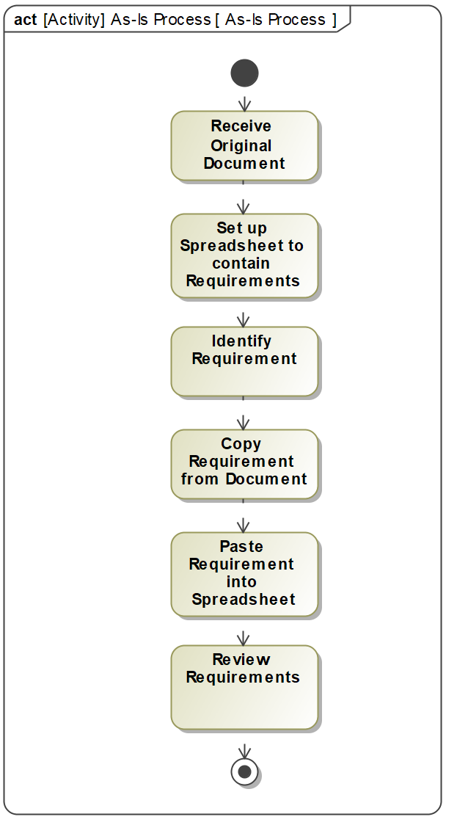
As-Is Process
AS-IS process of requirements definition
Reviewer takes the lengthy document (250+ documents) and read or search for key words
Take relevant text and cut and paste it into an Excel spreadsheet
Gaps
Reviewer may not be a domain expert to the system at hand
Miss relevant information: causing problems with communication and getting a complete understanding of the system
Take information that is not relevant: wasting time with irrelevant text
Inefficient and time consuming.
Notes:
Alex

Slide 6
Problem and Need Statement
Problem | Need
In Requirements Process: 1000+ Requirements multiple traceability properties to tests Demonstrations Reports | A way to manage the complexity and volume of requirements and their associated documents.
Large changing dataset means it is very costly to dedicate an engineer/s to keep track of the impacts of program modifications to requirements | Implement AI to better manage the requirement process.
Reviewer may not be a domain expert to the system at hand causing inefficiency.
Notes:
Alex

Slide 7
Agenda
Background
To-Be Process
Design and Implementation
Results
Prototype
Future Work
Notes:
Alex

Slide 8
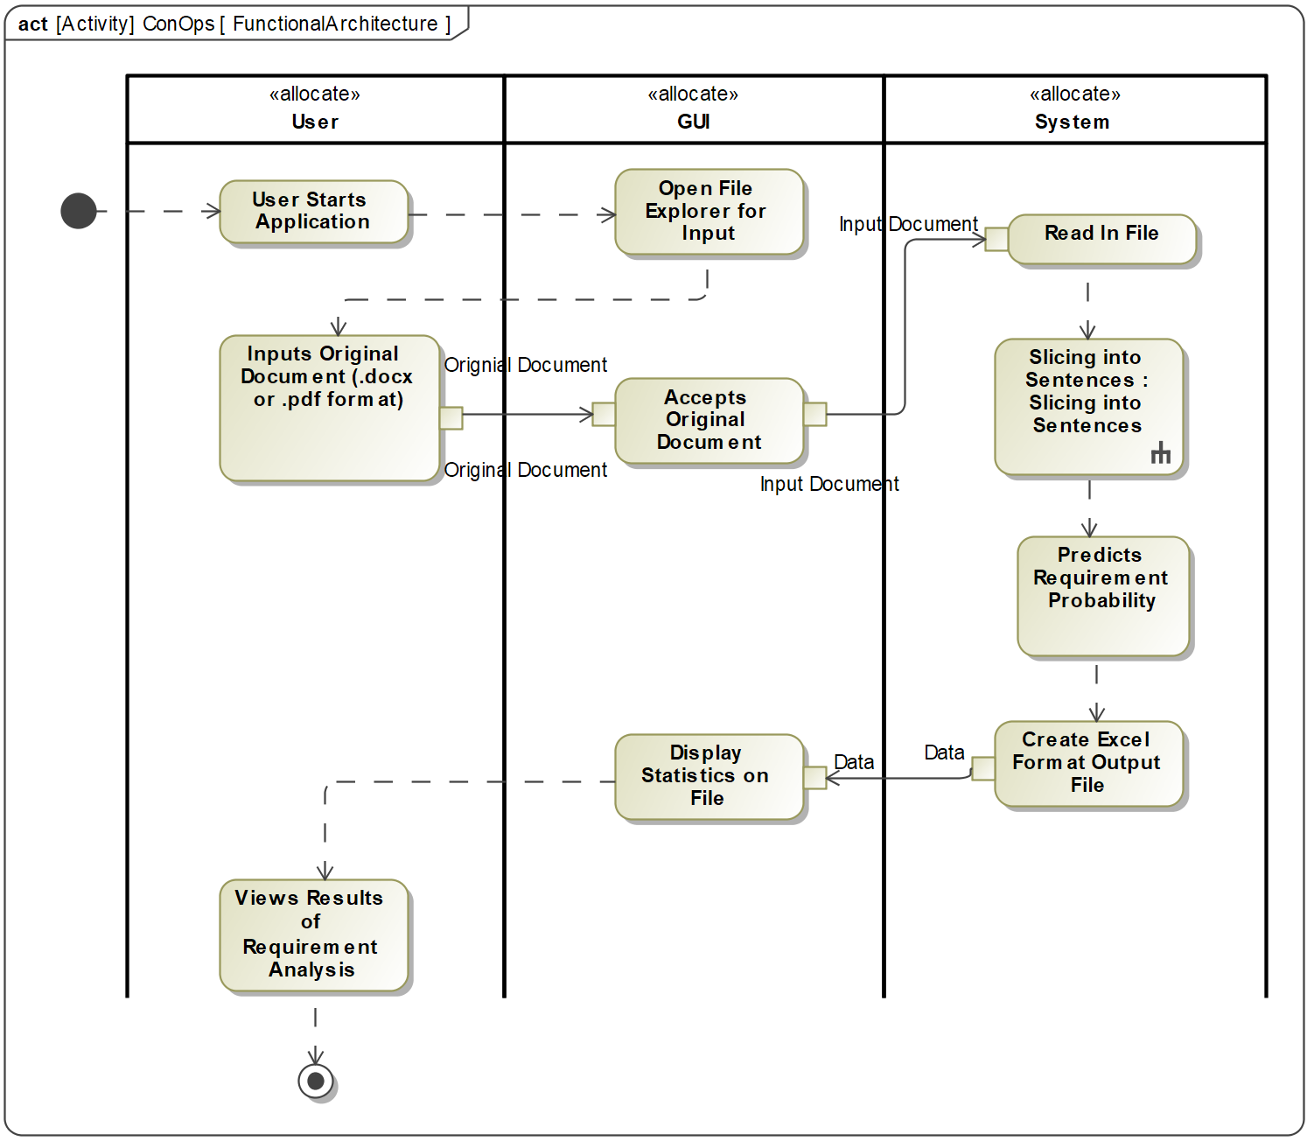
To-Be Process
Project Deliverables:
Sentence Slicer
Model Trainer
Requirement Predictor
Concept of Operations
Functional Architecture
Notes:
Alex

Slide 9
Agenda
Background
To-Be Process
Design and Implementation
Results
Prototype
Future Work
Notes:
Omid

Slide 10
Data Collection
1 = Requirement
0 = Not a Requirement
20 Requirement documents pre-processed
20,000 sentences to train AI
More documents to go
~25% sentences marked requirements
Released in 2018 by National Research Council of Italy
Source Repository: nlreqdataset.isti.cnr.it
Document | 1 | 0 | Grand Total
2000 - nasa x38 | 530 | 3691 | 4221
2001 - libra | 112 | 312 | 424
2001 - NPAC | 1747 | 6819 | 8566
2004 - ijis | 133 | 204 | 337
2004 - jse | 34 | 396 | 430
2004 - sprat | 129 | 388 | 517
2005 - clarus high | 140 | 314 | 454
2005 - triangle | 73 | 529 | 602
2006 - stewards | 88 | 931 | 1019
2007 - e-store | 105 | 71 | 176
2007 - water use | 282 | 776 | 1058
2008 - peering | 24 | 476 | 500
2008 - viper | 155 | 177 | 332
2008 - virtual_ed | 325 | 207 | 535
2009 - email | 96 | 309 | 405
2009 - library | 66 | 302 | 368
2009 - video search | 24 | 234 | 258
Grand Total | 4063 | 16136 | 20202
Notes:
Omid

Slide 11
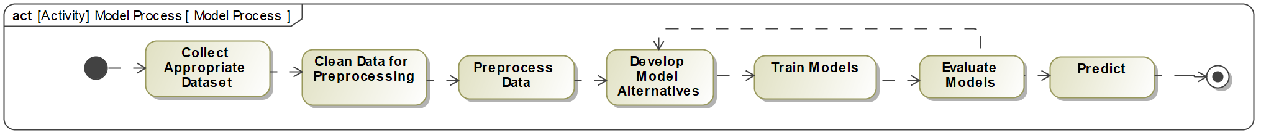
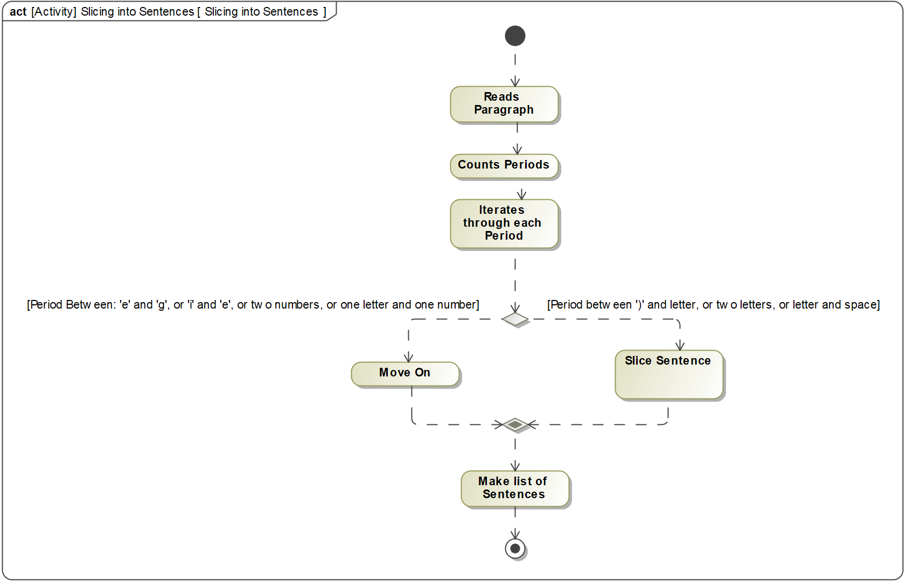
Functional Architecture of Deliverables: Slicing Sentences
1
2
3
1
Notes:
Omid

Slide 12
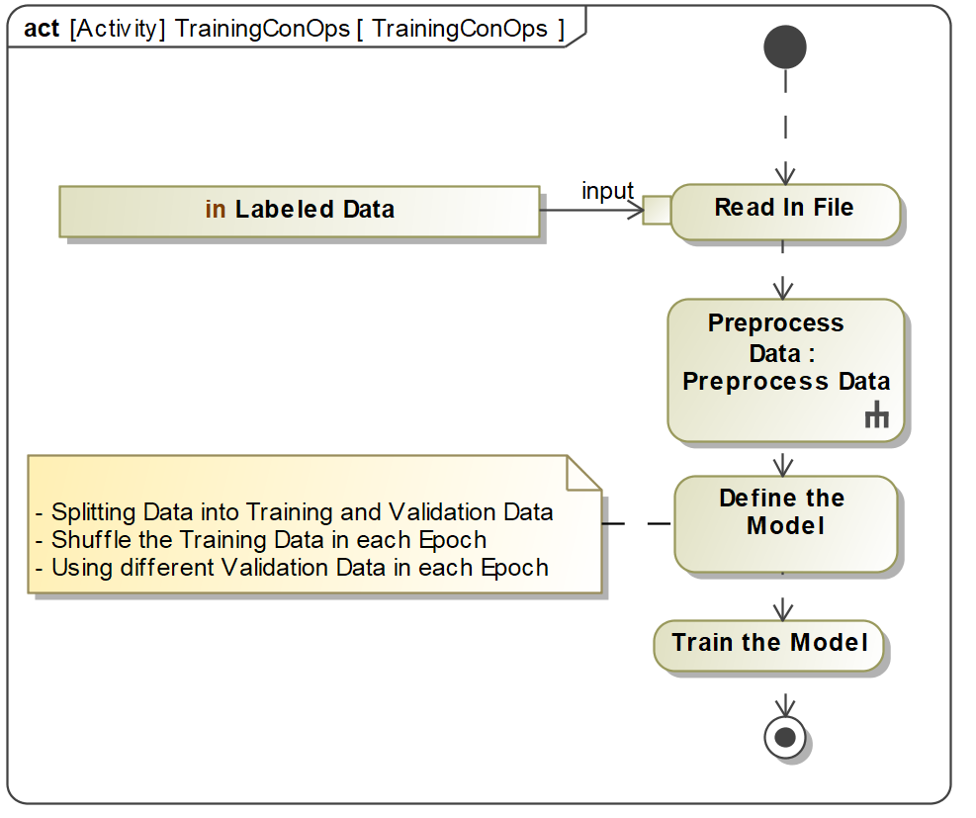
Functional Architecture of Deliverables: Training Models
1
2
3
2
Notes:
Omid

Slide 13
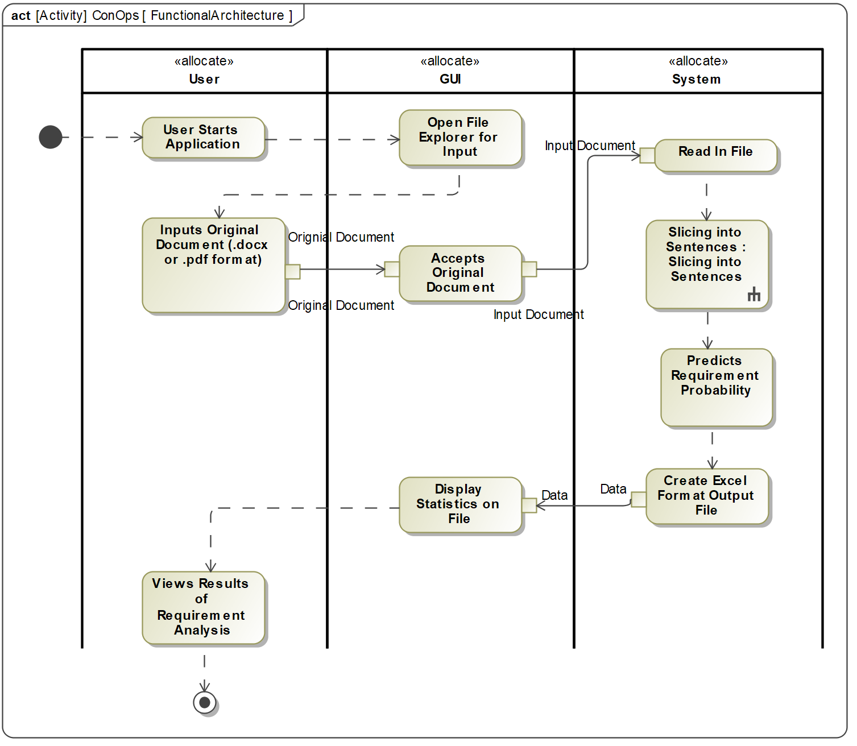
Functional Architecture of Deliverables: Predicting
1
2
3
3
Notes:
Omid

Slide 14
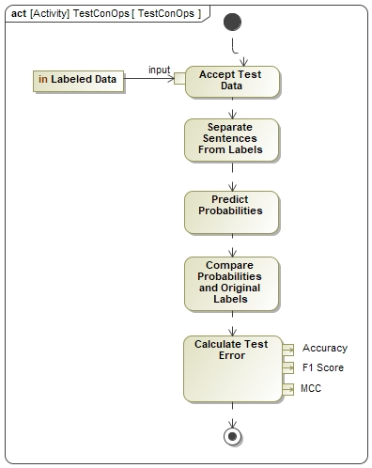
Model Performance and Evaluation
Notes:
Omid

Slide 15
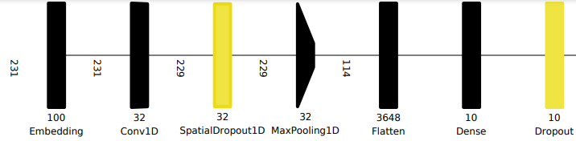
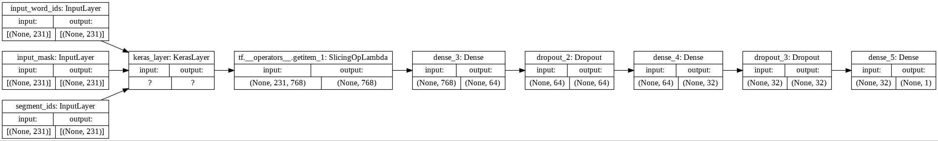
Model Alternatives
Fully Connected Neural Network
Consists of input layer, hidden dense layers and output layer
Uses a Bag of Words (BOW) method for encoding input sentences into the model
Convolutional Neural Network
Has convolutional layers in addition to the dense layer
One-dimension convolutional layer is used
BERT Model
Neural Network used for natural language processing that included BERT layer as an its Embedding layer (Developed by TensorFlow)
Used with either convolutional neural networks or regular fully connected neural networks
…
…
…
…
…
…
…
…
…
BERT Layer
…
…
…
…
…
…
…
Notes:
Omid

Slide 16
Agenda
Background
To-Be Process
Design and Implementation
Results
Prototype
Future Work

Slide 17
Model Prediction Combinations
One out of Three
Set of predictions predicts that a sentence is a requirement if at least one of the three base models (FNN, CNN, or BERT) predicts that the sentence is a requirement.
Two out of Three
Set of predictions predicts that a sentence is a requirement if at least two of the three base models (FNN, CNN, or BERT) predicts that the sentence is a requirement.
Three out of Three
Set of predictions predicts that a sentence is a requirement if all three base models (FNN, CNN, and BERT) predicts that the sentence is a requirement.
BERT and CNN Agree
Set of predictions predicts that a sentence is a requirement if both the BERT model and the CNN model predict that the sentence is a requirement.
BERT and FNN Agree
Set of predictions predicts that a sentence is a requirement if both the BERT model and the FNN model predict that the sentence is a requirement.
Notes:
Megan

Slide 18
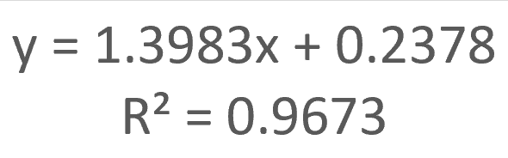
Model Results – Prediction Comparisons
Most # Sentences to Review
Elicit Most True Requirements
More review work for user BUT
more correct identifications
Least # Sentences to Review
Elicit Least True Requirements
Increasing the number of sentences to review by 10%, increases the number of requirements found by 13.9%.

Slide 19
Impact
Can reduce review load to engineer by 50% and still identify 90% of the true requirements.
OR Can reduce review load to engineer by 80% with the identification of 50% of the true requirements.
Identify future paths to take AI for Requirements Analysis.
 | More Workload | Less Workload
More Requirements Identified | 1 out of 3 CNN | BERT 2 out of 3
Less Requirements Identified | BERT and CNN Agree FNN | 3 out of 3 BERT and FNN Agree
Notes:
Megan

Slide 20
Agenda
Background
To-Be Process
Design and Implementation
Results
Prototype
Future Work
Notes:
MT

Slide 21
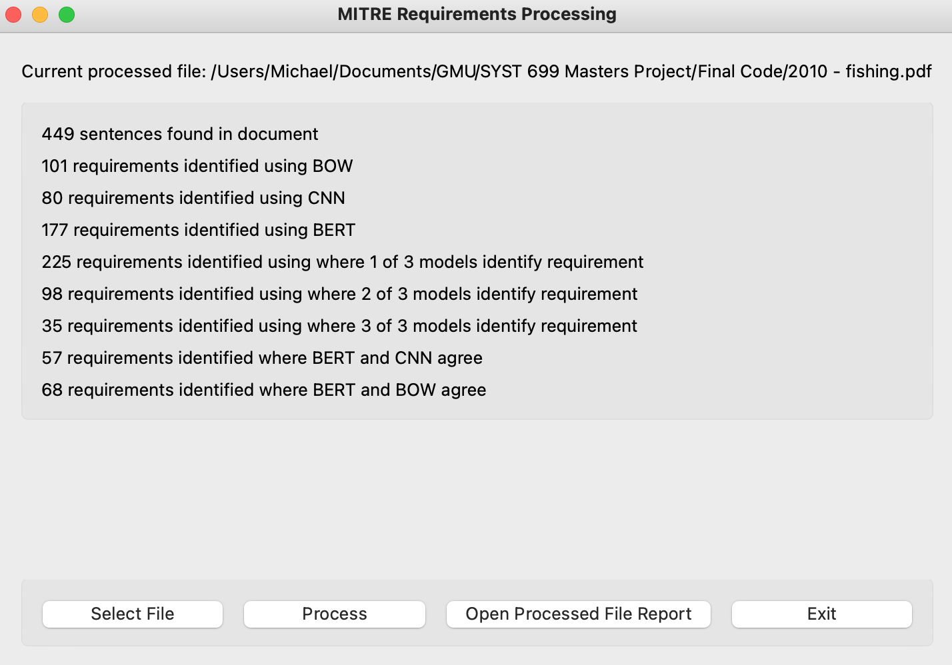
GUI
Functions:
Select file
Ingest file into AI
Display results
Open report
Notes:
MT

Slide 22
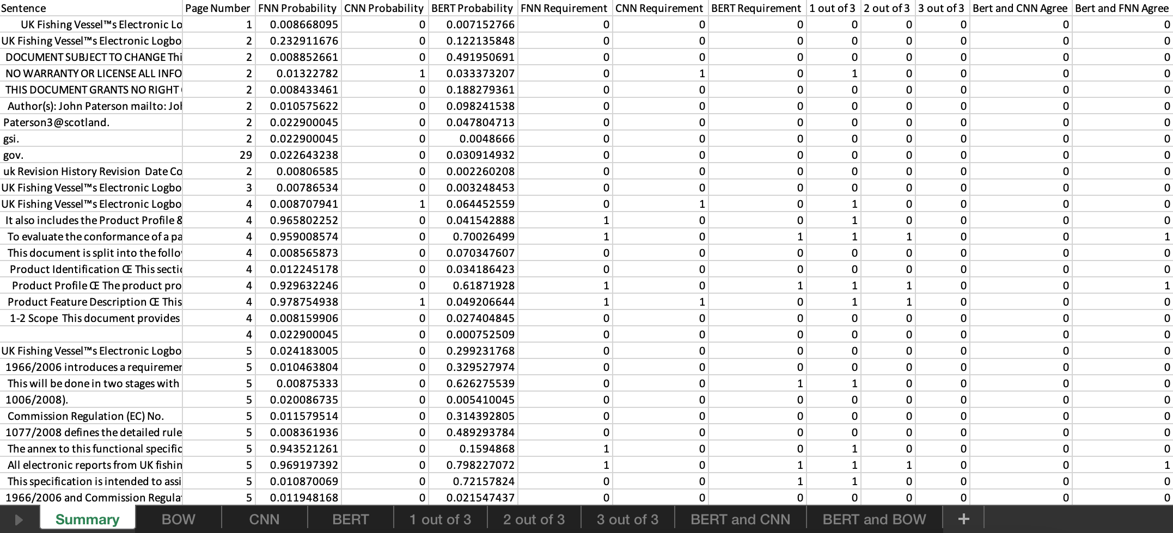
Prototype Output - Summary
Notes:
MT

Slide 23
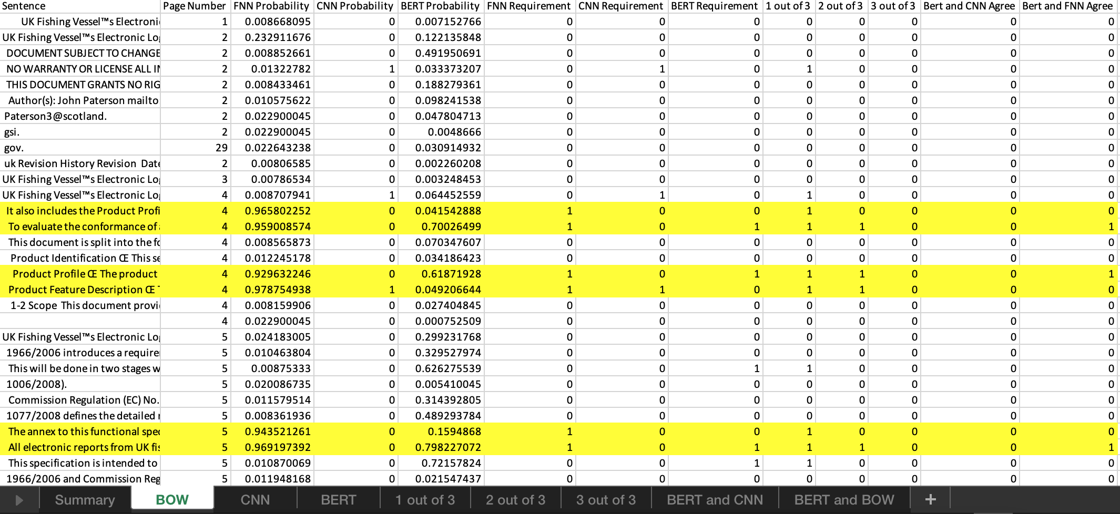
Prototype Output – BOW (FNN)
Notes:
MT

Slide 24
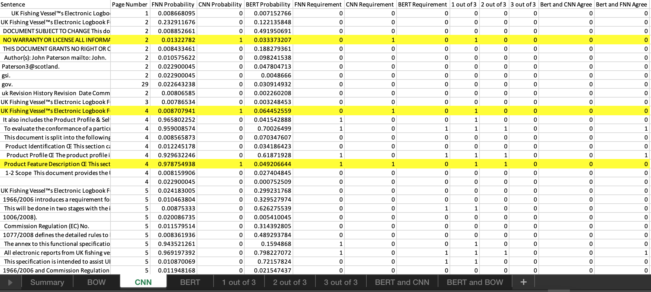
Prototype Output - CNN
Notes:
MT

Slide 25
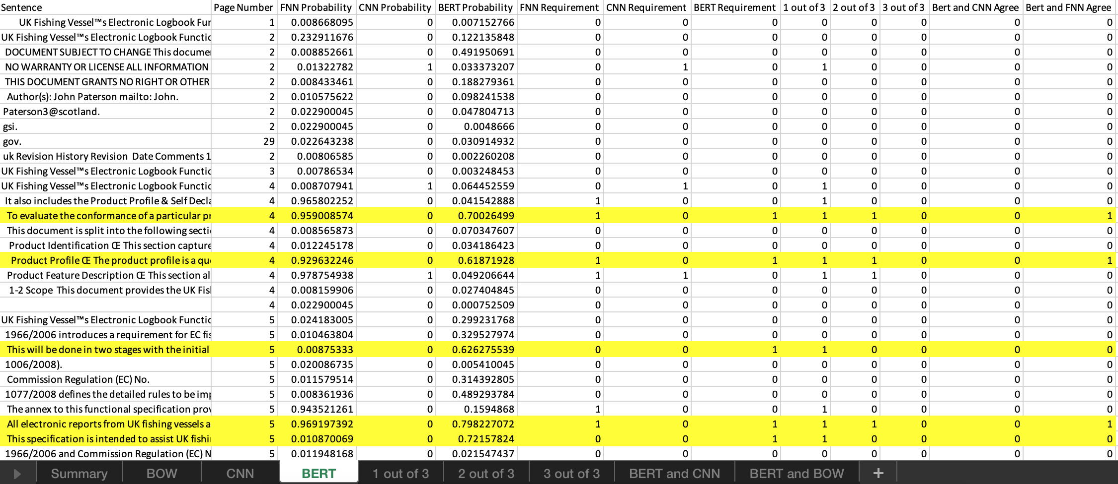
Prototype Output - BERT
Notes:
MT

Slide 26
Agenda
Background
To-Be Process
Design and Implementation
Results
Prototype
Future Work
Notes:
Alex

Slide 27
Future Work
Increase Accuracy
Add Stemming to the preprocessing.
Add more data to the training dataset.
Develop a custom BERT layer appropriate for the MITRE.
New Development
Create a model that can identify the subject of the requirements.
Create a model that can rewrite/correct a requirement in one document into one standard and correct format.
Train models on requirements documents of different industries individually.
Collecting Testing Metrics
Running multiple replications of each model to get a mean and standard deviation of the measurement scores.
Test with multiple test datasets.
Notes:
Alex

Slide 28

Questions

Slide 29
Back Up Slides

Slide 30

Concept Of Operations
Requirements Document
GUI
Sentences
Requirement Prediction Review
Predictions
Human Reviewer
AI
Consolidated Predictions
Sentence Predictions in Excel

Slide 31
AI in Systems Engineering
Many opportunities to integrate AI into the Systems Engineering process
“Implementing Augmented Intelligence in Systems Engineering” (2018)
Tracing requirements changes to SWAP-C (size, weight, power, and cooling) changes
Intelligent modeling to apply fault isolation strategically to system areas most prone to faults

Slide 32
Work Breakdown Structure (WBS)
WBS | Description | Duration | Start Date | Completion Date
1 | Class Deliverables | 85 days? | 2/11/2021 | 5/6/2021
1.1 | Draft Proposal | 1 day? | 2/11/2021 | 2/11/2021
1.2 | Final Proposal | 1 day? | 3/4/2021 | 3/4/2021
1.3 | Report Outline | 1 day? | 3/25/2021 | 3/25/2021
1.4 | Preliminary Report | 1 day? | 4/15/2021 | 4/15/2021
1.5 | SAGE Manuscript | 1 day? | 4/19/2021 | 4/19/2021
1.6 | Final Report | 1 day? | 4/29/2021 | 4/29/2021
1.7 | Final Presentation | 1 day? | 5/6/2021 | 5/6/2021
2 | Context Analysis | 30 days? | 2/1/2021 | 3/2/2021
2.1 | Research | 30 days? | 2/1/2021 | 3/2/2021
2.1.1 | Gap Analysis | 4 days? | 2/1/2021 | 2/4/2021
2.1.2 | AI integration | 30 days? | 2/1/2021 | 3/2/2021
2.2 | Stakeholder Interaction | 11 days? | 2/1/2021 | 2/11/2021
2.2.1 | System Scope Discussion | 8 days? | 2/1/2021 | 2/8/2021
2.2.2 | Document Procurement | 11 days? | 2/1/2021 | 2/11/2021
2.2.3 | Meeting Planning | 1 day? | 2/1/2021 | 2/1/2021
3 | Initial Prototype | 37 days? | 2/12/2021 | 3/20/2021
3.1 | Design | 23 days? | 2/12/2021 | 3/6/2021
3.1.1 | Requirement Definition | 5 days? | 2/16/2021 | 2/20/2021
3.1.2 | Pre-process Datasets | 14 days? | 2/12/2021 | 2/25/2021
3.1.3 | Build Prototype | 7 days | 2/21/2021 | 2/27/2021
3.1.4 | Train Prototype | 7 days | 2/28/2021 | 3/6/2021
3.2 | Test | 18 days? | 2/26/2021 | 3/15/2021
3.2.1 | Create Verification Test Plan | 11 days? | 3/2/2021 | 3/12/2021
3.2.2 | Create Test Dataset | 9 days | 2/26/2021 | 3/6/2021
3.2.3 | Conduct Test | 3 days | 3/13/2021 | 3/15/2021
3.3 | Retrospection | 5 days? | 3/16/2021 | 3/20/2021
3.3.1 | Analyze Test Results | 2 days | 3/16/2021 | 3/17/2021
3.3.2 | Stakeholder Feedback | 1 day? | 3/18/2021 | 3/18/2021
3.3.3 | Map Changes to Final Prototype | 2 days | 3/19/2021 | 3/20/2021
4 | Final Prototype | 47 days? | 3/21/2021 | 5/6/2021
4.1 | Design | 16 days? | 3/21/2021 | 4/5/2021
4.1.1 | Requirement Definition | 2 days | 3/21/2021 | 3/22/2021
4.1.2 | Pre-process Datasets | 7 days | 3/21/2021 | 3/27/2021
4.1.3 | Build Prototype | 7 days? | 3/23/2021 | 3/29/2021
4.1.4 | Train Prototype | 7 days? | 3/30/2021 | 4/5/2021
4.2 | Test | 3 days? | 4/6/2021 | 4/8/2021
4.2.1 | Create Verification and Validation Test Plan | 3 days? | 4/6/2021 | 4/8/2021
4.2.2 | Create Test Dataset | 3 days? | 4/6/2021 | 4/8/2021
4.2.3 | Conduct Sponsor Test | 3 days? | 4/6/2021 | 4/8/2021
4.3 | Retrospection | 28 days? | 4/9/2021 | 5/6/2021
4.3.1 | Analyze Test Results | 28 days? | 4/9/2021 | 5/6/2021
4.3.2 | Validate Test Results | 28 days? | 4/9/2021 | 5/6/2021
5 | Program Closeout | 1 day? | 5/7/2021 | 5/7/2021
5.1 | Software Handover | 1 day? | 5/7/2021 | 5/7/2021
5.2 | Document Handover | 1 day? | 5/7/2021 | 5/7/2021

Slide 33
Current Requirement Analysis Tools
“Requirements Analysis Tool: A Tool for Automatically Analyzing Software Requirements Documents” (2008)
Requirements Analysis Tool to perform semantic analysis over requirements document
Comparison to other AI SE tools: QuARS, Raven, KaOS
"QuARS: A Tool for Analyzing Requirements" (2005)
Detects linguistic inaccuracies or defects in requirements languages

Slide 34
Machine Learning for Requirements Identification
Sentiment
Semantic
Naïve Bayes
Logistic Regression
Neural Network
Support Vector Machines
Fully Connected
Convolutional
BERT
BERT = Bidirectional Encoder Representations from Transformers

Slide 35
Requirements

Slide 36
Mission Requirements
The system shall:
slice an original requirements document into individual sentences.
The system shall have the ability to be trained on labeled data.
predict the probability of being a requirement for each sentence with an MCC Score of at least 0.4.
Accept:
original requirements document from the user.
original requirements document in a PDF format.
original requirements document in a DOCX format.
output a CSV file with the requirement probability of each sentence using various models in the original requirements document.

Slide 37
Design Requirements – Slicing Sentences
The system shall
identify and read the paragraphs of an original requirements document.
count the periods within the paragraph.
iterate through each of the periods in the paragraph.
identify when the period is the end of the sentence.
identify the end of a sentence if the period is between a “)” and a letter.
identify the end of a sentence if the period is between two letters.
identify the end of a sentence if the period is between a letter and a space.
identify when the period is not at the end of the sentence.
identify that a period is not the end of the sentence if the period is between an “e” and a “g”.
identify that a period is not the end of the sentence if the period is between two numbers.
identify that a period is not the end of the sentence if the period is between a letter and a number.
compile and make a list of all the sentences that are identified.

Slide 38
Design Requirements - Training
The system shall:
read in a labeled data set.
preprocess the data.
make a list of sentences from the input list of data.
tokenize each sentence.
make a vocabulary.
embed each sentence.
define the models.
models shall:
split the data into training and validation data.
shuffle the training data in each epoch.
shall use different validation data in each epoch.
implement a sentiment model.
implement a Semantic model.
contain a BERT layer in at least on model.
train the model using the training data.

Slide 39
Design Requirements - Testing
The system shall:
accept the labeled test data.
separate the labels from the sentences.
predict the probability that they are a requirement.
compare the probabilities of being a requirement with the original labels.
calculate the test error.
calculate the model accuracy,
calculate the model F1 score.
shall calculate the model MCC.

Slide 40
Design Requirements - Output
The system shall output:
sliced sentences from the original requirements document.
the page number of the sentence from the original requirements document.
the requirement identification for each sentence.
the requirement identification for each sentence using the FNN model.
the requirement identification for each sentence using the CNN model.
output the requirement identification for each sentence using the BERT model.
the requirement identification for each sentence with a prediction that identifies the sentence as a requirement if at least one base model identifies the sentence as a requirement.
the requirement identification for each sentence with a prediction that identifies the sentence as a requirement if at least two base models identify the sentence as a requirement.
the requirement identification for each sentence with a prediction that identifies the sentence as a requirement if all three base models identify the sentence as a requirement.
the requirement identification for each sentence with a prediction that identifies the sentence as a requirement if both the semantic model and the CNN model identify the sentence as a requirement.
the requirement identification for each sentence with a prediction that identifies the sentence as a requirement if both the semantic model and the FNN model identify the sentence as a requirement.

Slide 41
Functional Architecture

Slide 42
Functional Architecture

Slide 43
Functional Architecture – Slicing Sentences

Slide 44
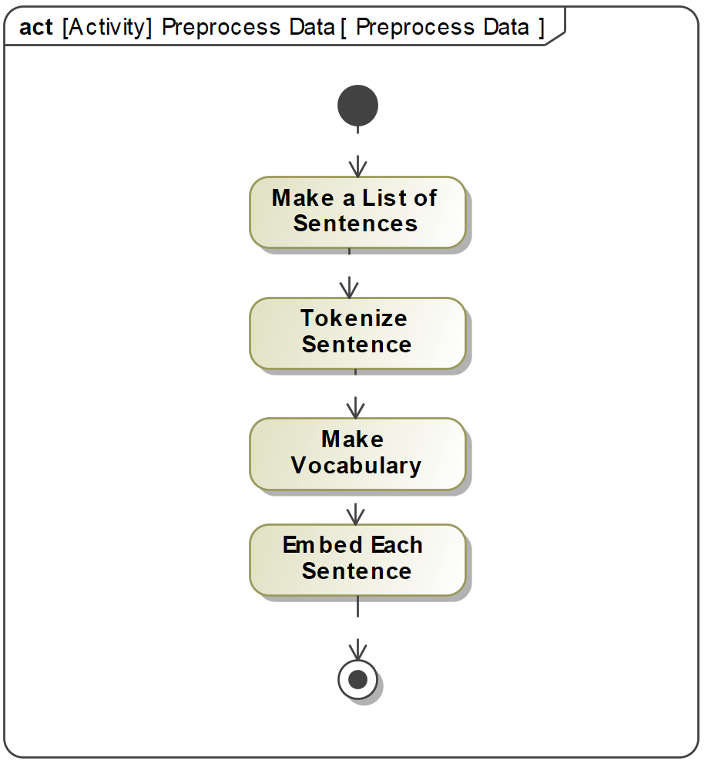
Functional Architecture - Training

Slide 45
Network Architecture: FNN Model
…
…
…
…
…
…
…
…
Input Layer
8447 Nodes
Dense
80 Nodes
Dropout
(0.2 nodes)
Dense
50 Nodes
Dropout
(0.2 nodes)
Dense
1 Nodes
Input Layer
Hidden Layers
Output Layer

Slide 46
Network Architecture: CNN Model
…
Dense
10 Nodes
Dropout
(0.2 Nodes)
Dense
1 Node
Input Layer
231 Nodes
Input Layer
Hidden Layers
Output Layer

Slide 47
Network Architecture: CNN Model
…
Dense
10 Nodes
Dropout
(0.2 Nodes)
Dense
1 Node
Input Layer
231 Nodes
Input Layer
Hidden Layers
Output Layer

Slide 48
Network Architecture: Semantic Model
BERT Layer
…
…
…
…
…
…
…
Dense
64 Nodes
Dropout
(0.2 Nodes)
Dense
32 Nodes
Dropout
(0.2 Nodes)
Dense
1 Nodes
Input Layers
Hidden Layers
Output Layer

Slide 49
Objectives
Train the AI model
Take in a DOCX or PDF original requirements document.
Separate the document into the sentences within the document.
Predict whether a sentence is a requirement or not.
Return a CSV that contains the predictions and requirement identification
Columns | Data Type
Requirement Statement | String
Requirement Prediction (for each model) | Percentage
Page | Integer

Slide 50
Assumptions
Data labels are consisted of those statements that were explicit requirements and sentences that were functions of the system. This is an attempt to capture all aspects of a system that may become a requirement.
This process does not cover the whole requirements analysis process but is an attempt to reduce the time it takes to search entire documents for requirements.
The models are not able to differentiate different subjects of requirements, just identify that they are requirements.

Slide 51
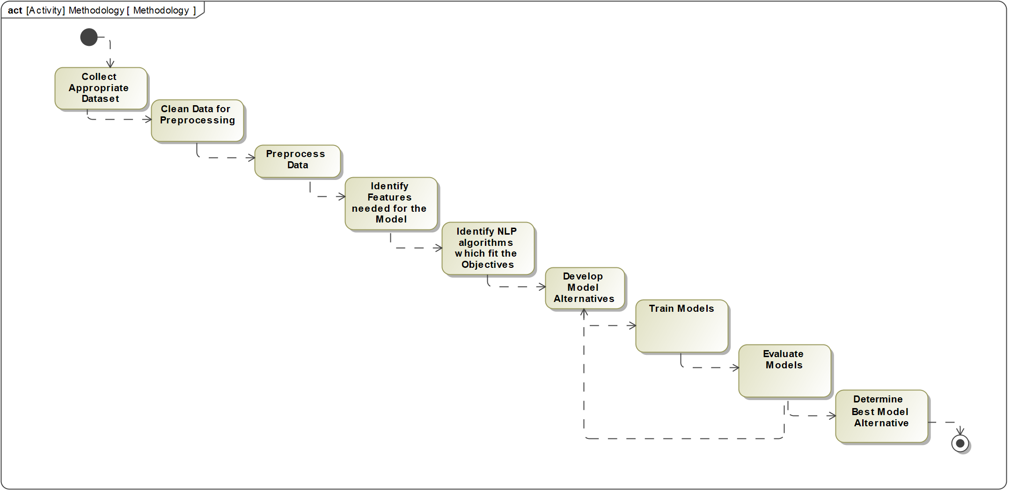
Methodology for Developing an AI Prototype

Slide 52
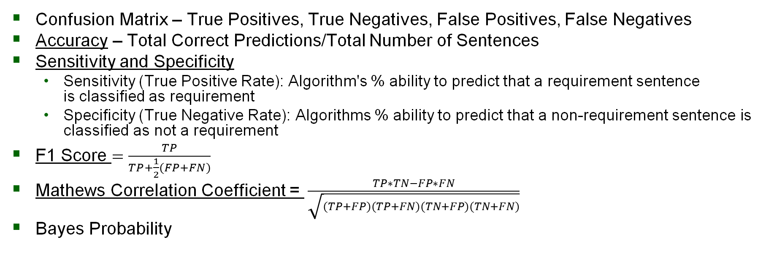
Neural Network Metrics
Confusion Matrix – True Positives, True Negatives, False Positives, False Negatives
Accuracy – Total Correct Predictions/Total Number of Sentences
Sensitivity and Specificity
Sensitivity (True Positive Rate): Algorithm's % ability to predict that a requirement sentence is classified as requirement
Specificity (True Negative Rate): Algorithms % ability to predict that a non-requirement sentence is classified as not a requirement
F1 Score $=\frac{TP}{TP+\frac{1}{2}(FP+FN)}$
Mathews Correlation Coefficient = $\frac{TP∗TN−FP∗FN}{\sqrt{(TP+FP)(TP+FN)(TN+FP)(TN+FN)}}$
Bayes Probability

Slide 53
Model Results - Metrics
 | FNN | CNN | BERT | 1 Out of 3 | 2 out of 3 | 3 Out of 3 | BERT&CNN Agree | Bert & FNN agree | Notes
Accuracy | 0.77 | 0.76 | 0.76 | 0.69 | 0.79 | 0.81 | 0.79 | 0.80
F1 | 0.58 | 0.65 | 0.58 | 0.61 | 0.64 | 0.56 | 0.61 | 0.57 | Does not account for True Negatives in Calculation – Problem for biased data
MCC | 0.26 | 0.39 | 0.28 | 0.42 | 0.32 | 0.22 | 0.27 | 0.22 | Accounts for True Negatives and True Positives
Sensitivity | 0.61 | 0.88 | 0.68 | 0.94 | 0.73 | 0.50 | 0.63 | 0.52 | Green - Best at Identifying Requirements
Specificity | 0.83 | 0.72 | 0.78 | 0.61 | 0.81 | 0.91 | 0.85 | 0.90 | Green - Best at Identifying Non-Requirements

Slide 54
Strategy 1: Greatest Percent Requirements Identified
1 Out of 3 Model
Greatest Percent of the Requirements given to the Reviewer (93% based on Test Data)
Only need to review half of the sentences from the entire document

Slide 55
Strategy 2: Least Sentences to Review
3 out of 3 or Bert and FNN Agree
Least Percent of Requirements Identified (About 50% based on Test Data)
Least Number of Sentences to Review (About 20% of the document)

Slide 56
Strategy 3: Balance Number of Sentences to Review and Percent of Identified Requirements
Choose a prediction method in between the other models
Balance the Error (1-Percent of True Requirement Identified) and the number of requirements to review.

Slide 57
Verification and Validation

Slide 58
Verification
All requirements verified by: Analysis, Demonstration, Inspection, or Test
Demonstration and Test artifacts verified by WBS test events
Requirement ID | Description | Verification Method | Verification Artifact
7.2.1 | The system shall slice an original requirements document into individual sentences. | Test | 3.1.2
7.2.2 | The system shall predict the probability of being a requirement for each sentence with an MCC Score of at least 0.4. | Test | 4.2.3
7.2.3 | The system shall accept an original requirements document from the user. | Demonstration | 3.2.3
7.2.3.1 | The system shall accept an original requirements document in a PDF format. | Demonstration | 3.2.3
7.2.3.2 | The system shall accept an original requirements document in a DOCX format. | Demonstration | 3.2.3

Slide 59
Validation
Validation meetings held with sponsor (MITRE)
Presented initial and final prototype results and received feedback to incorporate into system
Presented GUI design and also received feedback
Sponsor satisfied with results

Slide 60
Challenges With Developing an AI Prototype
Data Collection
Data Labeling
Difficulty of slicing documents into sentences
Differing Perceptions of Identifying Requirement from Non-Requirements
High Computation Cost
Increasing Test Accuracy of Models

Slide 61
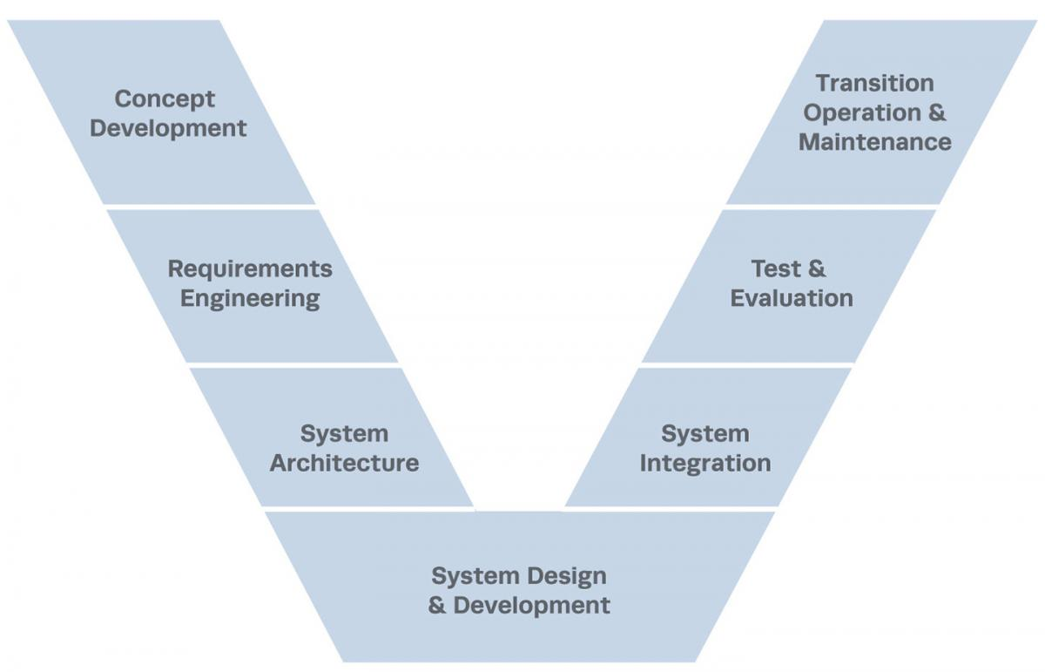
Methodology for incorporating AI into the System Engineering
Investigate how AI may be utilized to streamline the system engineer process
For each item on the ‘V’, determine if AI may be applied in order to save time and effort (money)
Generate report of findings

Slide 62
Resources Used
Python Packages:
Numpy
Pandas
Nltk
Matplotlib
Keras
tensorflow
Sample dataset(s) - National Research Council of Italy (2018)
Source Repository: nlreqdataset.isti.cnr.it

